Slide 1





Dependency Injection and Services
A great pattern to follow
DI
and Services
SoftUni Team
Technical Trainers
Software University
http://softuni.bg

Slide 2

Table of Contents
Dependency Injection Overview
Creating custom services
Making your own Injectables
Observables and RxJS
Functional Reactive Programming (FRP)
HTTP Service

Slide 3
Have a Question?
sli.do #angular-js

Slide 4

Dependency Injection Overview
A design pattern in programming

Slide 5
What is a Dependency ?
Another object that your class needs
Other Examples (Framework, Database, File System, Providers)
Classes dependent on each other are called coupled
Dependencies are bad because they decrease reuse.
public class Customer {
customerService = new CustomerService('Service');
}
Customer class is dependent on concrete service

Slide 6
Dependency Examples
Project
Framework
Service
Database
Class
Another Class

Slide 7
Dependency Injection
Dependency Injection is a popular design pattern
Inversion of Control (IoC)
Dependencies are pushed in the class from the outside
The class does not instantiate it's dependencies
public class Customer {
private customerService;
constructor(CustomerService cService) {
this.customerService = cService;
}
}
The service comes from outside

Slide 8

Dependency Injection (2)
How it should be
Classes should declare what they need
Constructors should require dependencies
Dependencies should be abstractions
How to do it
Dependency Injection (usually called DI)
The Hollywood principle "Don't call us, we'll call you!"

Slide 9


Constructor Injection
Dependencies – through constructors
Pros
Classes self document requirements
Works well without container
Always valid State
Cons
Many parameters
Some methods may not need everything

Slide 10
Classic Violations
Using the new keyword
Using static methods/properties
The class is brittle, inflexible and hard to test
public class Laptop {
public battery: Battery;
public videoCard: VideoCard;
constructor() {
this.battery = new Battery('Acer battery');
this.videoCard = new VideoCard('Nvidia 960 GTX');
}}

Slide 11
How to fix ?
Add the dependencies through the constructor
Create whatever model you like
constructor(public videoCard: VideoCard, public battery: Battery)
let firstLaptop = new Laptop(new VideoCard('Nvidia 940m'), new Battery('Acer Battery'));
let secondLaptop = new Laptop(new VideoCard('Radeon 280x'), new Battery('Toshiba Battery'));

Slide 12

General Requirements
A class should receive it's dependencies from external sources rather than creating them itself
Decouple dependencies through constructor injection
Your code should be easier to test
Additional information: https://angular.io/guide/dependency-injection-pattern

Slide 13

Creating Custom Services
Making your own Injectables

Slide 14
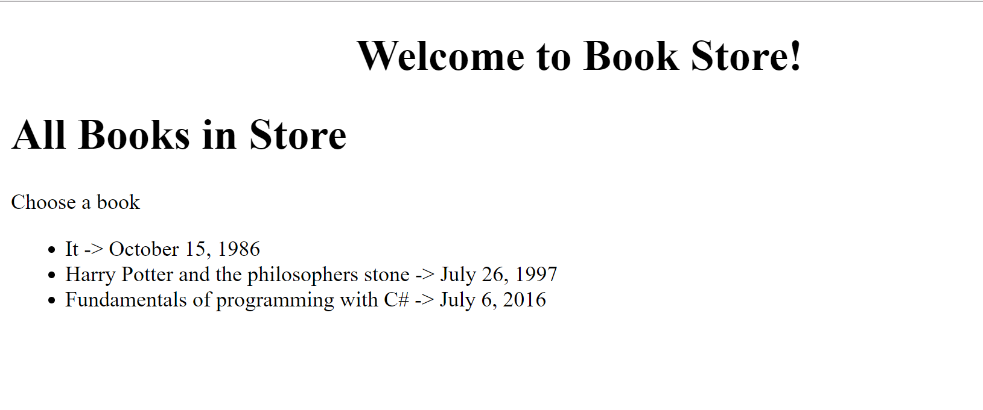
Problem: Create a Simple Book Store
Create Books component
Inject a service into the component

Slide 15
Create Book Model
Create a Book class to hold information about a book
Title, author, price and published on (date)
export class Book {
title : string;
author : string;
price : number;
publishedOn : Date;
constructor(title : string, author : string, price : number, publishedOn : Date) {
// bind the parameters to the properties
}}

Slide 16
Create a Service
Create a service class that returns an array of books
import { Book } from "./book";
export class BooksService {
getData() : Book[] {
return [
new Book('It', 'Stephen King', 23.2, new Date(1986, 9, 15)),
new Book('Harry Potter and the philosophers stone', 'J.K Rowling', 22.1, new Date(1997, 6, 26)),
new Book('Fundamentals of programming with C#', 'Svetlin Nakov', 50, new Date(2016, 6, 6)),
]}
}

Slide 17
Create a Component
Create a books component and use the service
import { Component, OnInit } from '@angular/core'
import { BooksService } from './books.service'
@Component({ selector: 'books', templateUrl: '…'})
export class BooksComponent implements OnInit {
public books : Book[];
ngOnInit(): void {
this.books = new BooksService().getData();
}
}
Creating instances is wrong!

Slide 18
Injectable Service
In order to inject a service import a decorator
Call the decorator function on top of the Books Service
import { Injectable } from '@angular/core';
Essential ingredient in every Angular service
@Injectable()
export class BooksService {
getData() : Book[] {
return // Books array
}
}

Slide 19
Register a service provider
A service is just a class until you register it with an Angular dependency injector
Add the service in the component providers array
@Component({
selector: 'books',
templateUrl: './books.component.html',
providers: [ BooksService ]
})
export class BooksComponent implements OnInit {
public books : Book[]
// Continues … }

Slide 20
Register a service provider (2)
Apply constructor injection to inject the service
// Continued …
constructor (
private booksService : BooksService
) { }
ngOnInit() {
this.books = this.booksService.getData();
}
Creates a private property

Slide 21
App Module Providers
Make the service available globally
This is done only when needed!
import { BooksService } from './books/books.service';
@NgModule({
declarations: [
AppComponent,
BooksComponent],
imports: [ BrowserModule ],
providers: [
BooksService
],…})
The service can be injected into any component

Slide 22

Observables and RxJS
Intro to FRP

Slide 23
Functional Programming
Functional Programming is introduced in JS since ES6
Easier array manipulation using (map, filter, reduce, etc.)
Front-end programming is asynchronous
Using a stream to handle asynchronous operations
0, 1, 2, 3, 4
A stream of numeric values

Slide 24
The Observable
In Angular we handle streams using Observables
Create Streams
Subscribe to Streams
React to new values
Combine streams to build new ones
[ 0, 1, 2, 3, 4 ]
Handle a stream as an array

Slide 25

Function Reactive Programming
FRP is a paradigm for software development
Entire programs can be build uniquely around the notion of streams
Create, combine and subscribe to streams
The core goal of FRP
Build programs in a declarative way
Lack of application state variables

Slide 26
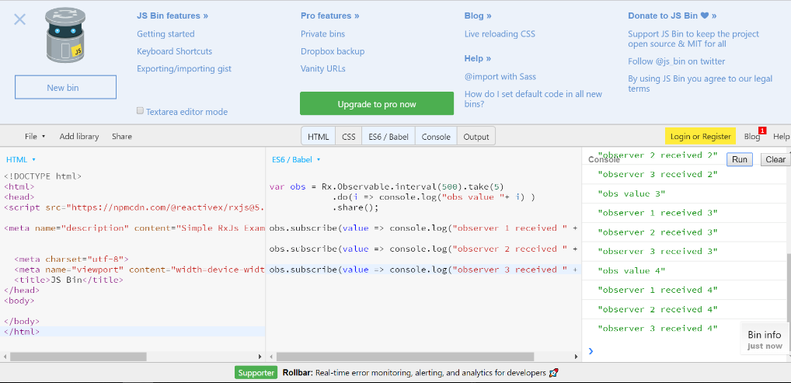
Introducing RxJS
Stands for Reactive Extensions for JavaScript
Implementation Library for Observables
To see in action use JsBin: https://jsbin.com/laxogo/edit?html,js,console
let obs = Rx.Observable.interval(1000).take(5);

Slide 27
Observables Side Effect
Using the do operator
Observables are either hot or cold
We need to subscribe to them
let obs = Rx.Observable.interval(1000).take(5).do(I => console.log(i));
Has no subscribers (cold)
obs.subscribe(i => console.log(i));
Has a subscriber (hot)

Slide 28
Observables Side Effect (2)
Observables are not shared by default
Creating a subscriber sets up a whole new separate processing chain
Two things to keep in mind:
Is the observable hot or cold ?
Is the observable shared or not ?
obs.subscribe(i => console.log(`first sub ${i}`));
obs.subscribe(i => console.log(`second sub ${i}`));

Slide 29
Commonly Used RxJS Operators
The map operator
The filter operator
The reduce operator
let obs = Rx.Observable.interval(1000).take(5).map(i => 2 * i)
let obs = Rx.Observable.interval(1000).take(5).filter(i => i % 2 == 0)
The heart of Redux ☺
let obs = Rx.Observable.interval(1000).take(5).reduce((state, value) => state + value, 0)

Slide 30
Commonly used RxJS Operators (2)
The scan operator
The share operator
let obs = Rx.Observable.interval(1000).take(5).scan((state, value) => state + value, 0)
let obs = Rx.Observable.interval(1000).take(5).do(I => console.log(`value: ${i}`)).share();
Share a single subscription of a processing chain

Slide 31
RxJS and FRP Overview
RxJS and FRP are really powerful concepts
Multiple choice to structure an Angular app
Go full reactive (extensive use of RxJS)
Via parts (Forms or Http)
More on observables here: https://blog.angular-university.io/functional-reactive-programming-for-angular-2-developers-rxjs-and-observables/

Slide 32


HTTP Service
Fetching data from a remote API

Slide 33
The HTTP Client Module
Before we can use the HttpClient to fetch data, import the HttpClientModule in "app.module".
Add the module in imports array
import { HttpClientModule } from '@angular/common/http'
@NgModule({
declarations: [ // App Components ],
imports: [
BrowserModule,
HttpClientModule
],
From now on HttpClient can be injected in Services

Slide 34
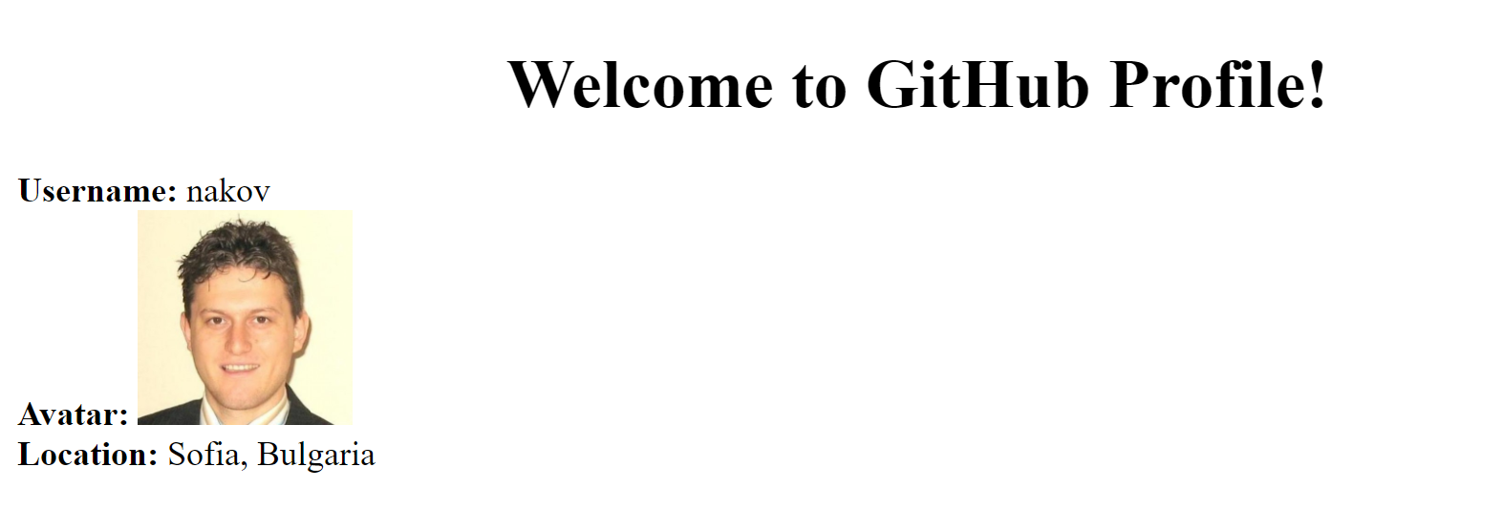
Problem: Fetch Data from GitHub
Display profile info from GitHub api
Inject the HttpClient into a Service
Handle the Observable.

Slide 35
Injecting the HttpClient
import { Injectable } from '@angular/core'; import { HttpClient } from '@angular/common/http'
import { Observable } from 'rxjs/Observable';
@Injectable()
export class GitService { constructor( private http : HttpClient ) { }
getProfileInfo() : Observable<Object> {
const url = 'https://api.github.com/users/nakov';
return this.http.get<Object>(url);
}}
HttpClient retrieves an Observable, not a Promise

Slide 36
Subscribe to the Observable
Inject a service and subscribe to observables
export class GitComponent implements OnInit {
profileData : Object; constructor(
private gitService : GitService
) { }
ngOnInit(): void {
this.gitService.getProfileInfo()
.subscribe(data => {
this.profileData = data;
});
} }

Slide 37
Typechecking the response
It is recommended to cast the response
getProfileInfo() : Observable<GitProfile> {
const url = 'https://api.github.com/users/nakov';
return this.http.get<GitProfile>(url);
}
interface GitProfile {
login : string;
avatar_url : string;
location : string
}
Could be a class/interface

Slide 38
Catching Errors
To handle errors add an error handler to subscribe call
ngOnInit(): void {
this.gitService.getProfileInfo()
.subscribe(
data => { // Attach data to prop},
err => {
console.log(`Something went wrong: ${JSON.stringify(err)}`) }
)
}
The error can differ depending on the API

Slide 39
Making a POST request
To create a post request we need body, headers, etc..
const body = { username: 'Pesho', password: 'pass1234'}
http
.post('api/users', body, {
headers: new HttpHeaders().set('Authorization', 'authtoken')
})
.subscribe(…)
Always subscribe to observables, nothing will happen otherwise

Slide 40
Using Promises
Casting an Observable to Promise
More info at: : https://angular.io/guide/http
import 'rxjs/add/operator/toPromise';
getProfileInfo() : Promise<GitProfile> {
const url = 'https://api.github.com/users/nakov';
return this.http.get<GitProfile>(url)
.toPromise()
.then(data => this.profileData = data)
.catch(err => console.warn(`ERR: ${err}`));
}

Slide 41

Summary
DI is a popular design pattern
Injecting services in Angular is easy
RxJS and FRP are really powerful concepts
Use the HttpClient to fetch data from an API
@Component({
providers: [ UsersService ]
})
this.http.get(url).retry().pipe().subscribe()

Slide 42







JavaScript Web – Angular Fundamentals
https://softuni.bg/courses/

Slide 43
License
This course (slides, examples, demos, videos, homework, etc.) is licensed under the "Creative Commons Attribution-NonCommercial-ShareAlike 4.0 International" license
Attribution: this work may contain portions from
"End-to-end JavaScript Applications" course by Telerik Academy under CC-BY-NC-SA license

Slide 44





Trainings @ Software University (SoftUni)
Software University – High-Quality Education, Profession and Job for Software Developers
softuni.bg
Software University Foundation
http://softuni.foundation/
Software University @ Facebook
facebook.com/SoftwareUniversity
Software University Forums
forum.softuni.bg

